Slide 1
How to unreceive an item received from a POL
Yoel Kortick
Senior Librarian

Slide 2

Agenda
Introduction
An example
Unreceive the item

Slide 3
Introduction

Slide 4
Introduction
The "un-receive" button appears in the receiving workbench for both 'One Time' and 'Continuous' orders if
  The item was already received
  The item is in the acquisitions department (which means there is a work order on the item because "Keep in Department" was checked while receiving the item)
  There are no patron requests or library requests on the item
See also Un-Receive an Item at Receiving Physical Material.

Slide 5
Introduction
When an item is un-received:
  The receiving date is removed from the item
  The work order status is removed
  The item is no longer located in the Receiving department's list of In Process items.
Merely deleting a receiving date does not properly un-receive an item.
If an item is received and is in place, it will remain in place, even if the item is edited and the receiving date is deleted.

Slide 6
An example

Slide 7

An example
The staff user is at the "Main Library - Acquisitions Department"

Slide 8
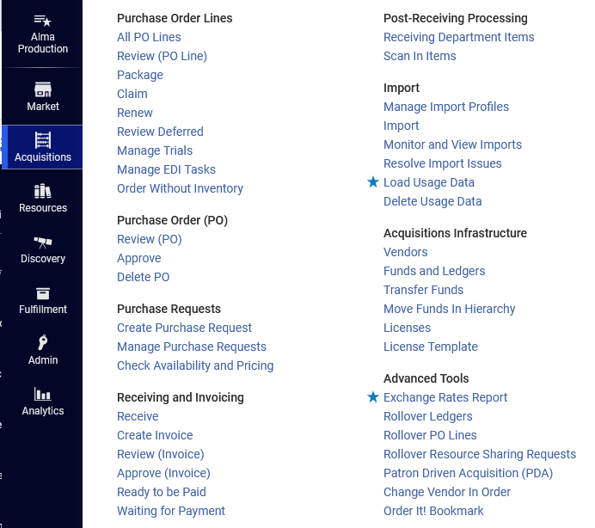
An example
The staff user selects "Acquisitions > Receiving and Invoicing > Receive"

Slide 9
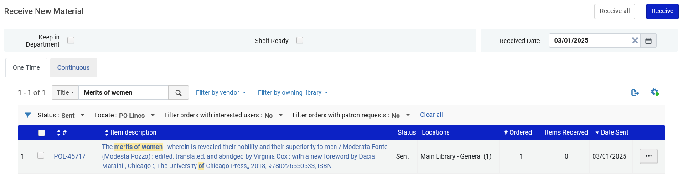
An example
POL-46717 title "The merits of women : wherein is revealed their nobility and their superiority to men" is in status sent and appears on the "Receive New Material" page

Slide 10
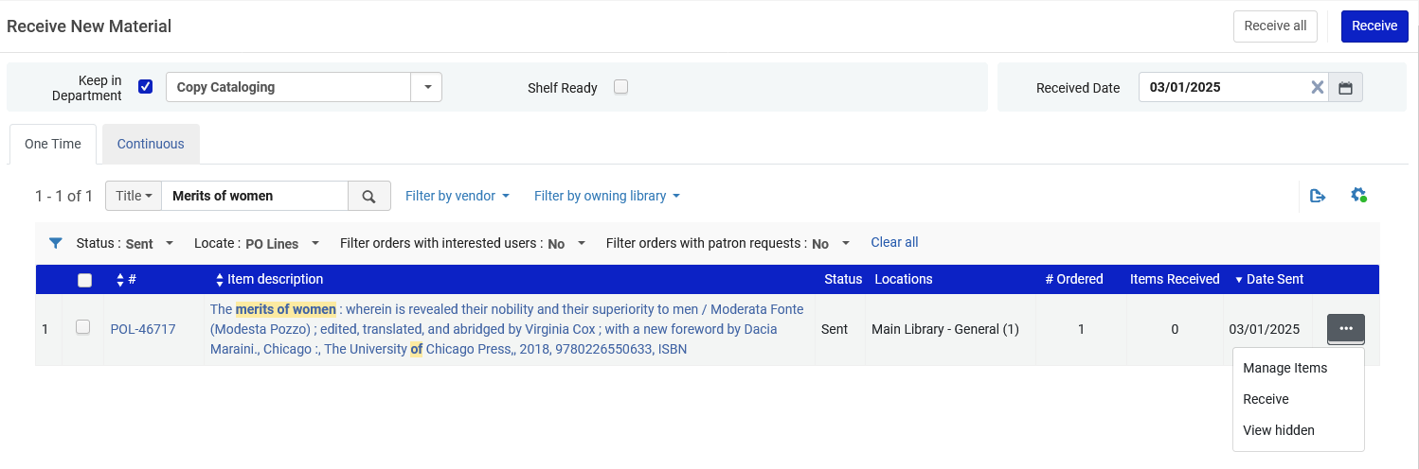
An example
The staff user selects "Keep in department" and receives the item
This will create a work order on the received item
Here we receive the item

Slide 11
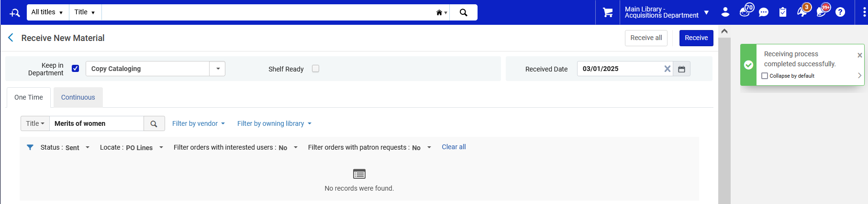
An example
The staff user sees that the receiving process completed successfully.

Slide 12
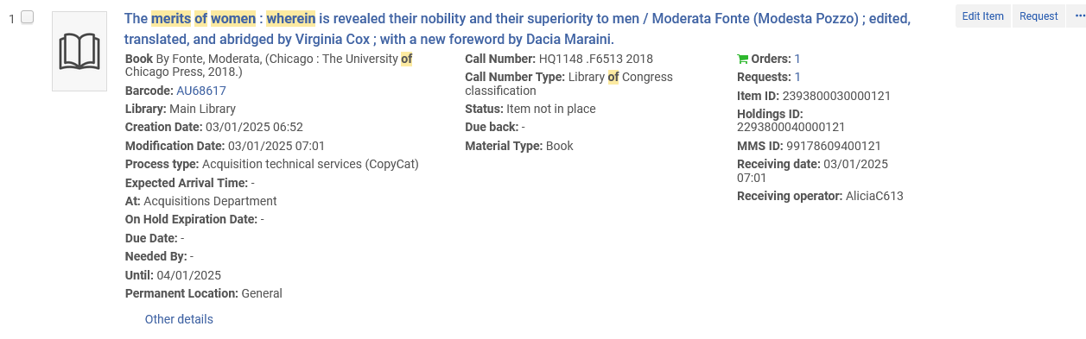
An example
A physical items search for the received item shows it as
  Status: Item not in Place
  Process type: Acquisition technical services (CopyCat)
  At: Acquisitions Department
  Receiving Date: Jan. 03, 2025

Slide 13
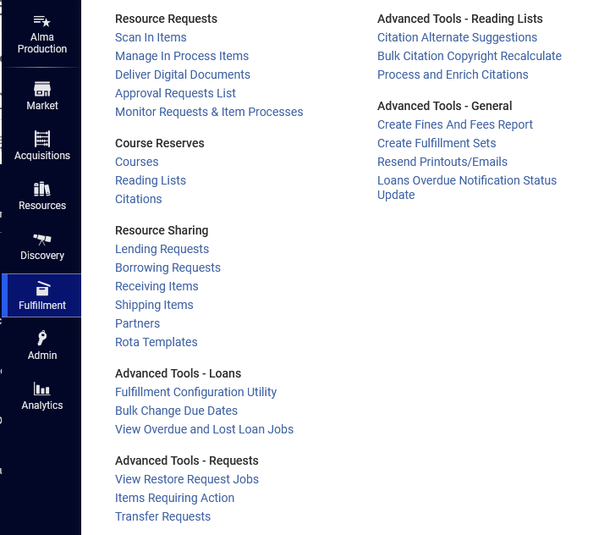
An example
While still at the "Main Library – Acquisitions Department" the staff user does "Fulfillment > Resource Requests > Monitor Requests & Item Processes"

Slide 14
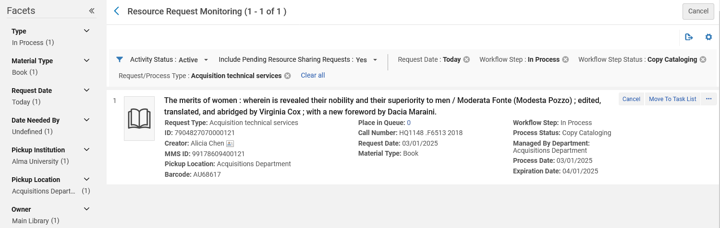
An example
The staff user sees that there is a work order on the item with "Workflow step: In Process", "Workflow Step Status: Copy Cataloging" and "Request/Process Type "Acquisitions technical services"

Slide 15
Unreceive the item

Slide 16
Unreceive the item
The staff user realizes that a mistake was made and the item from POL-46717 title "The merits of women : wherein is revealed their nobility and their superiority to men" should not have been received.
The staff user accesses the "Receive New Material" page at "Acquisitions > Receiving and Invoicing > Receive" and retrieves the POL.
The staff user clicks "Manage Items"

Slide 17
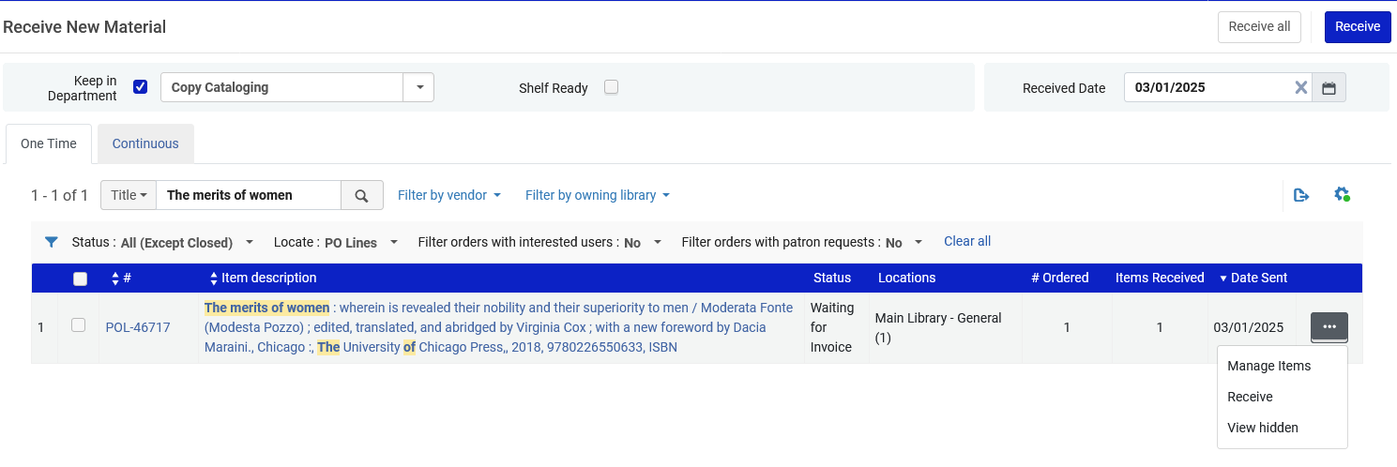
Unreceive the item
The staff user accesses the "Receive New Material" page at "Acquisitions > Receiving and Invoicing > Receive"
The staff user clicks "Manage Items"

Slide 18
Unreceive the item
After clicking "Manage Items" the staff user arrives to the "Received Items List"
From here the staff user has an option to "Unreceive".
The staff user clicks "Unreceive"

Slide 19
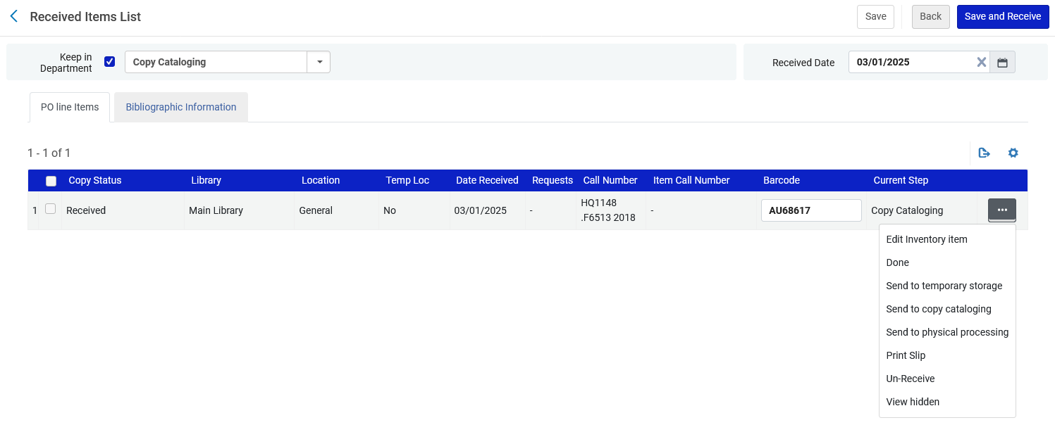
Unreceive the item
The staff user clicks "Unreceive"

Slide 20
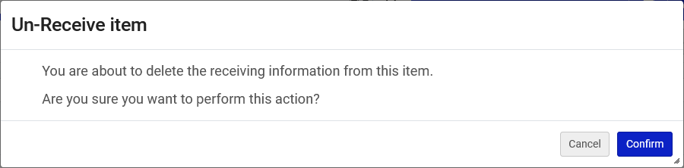
Unreceive the item
The staff user confirms the "Un-Receive item" message

Slide 21
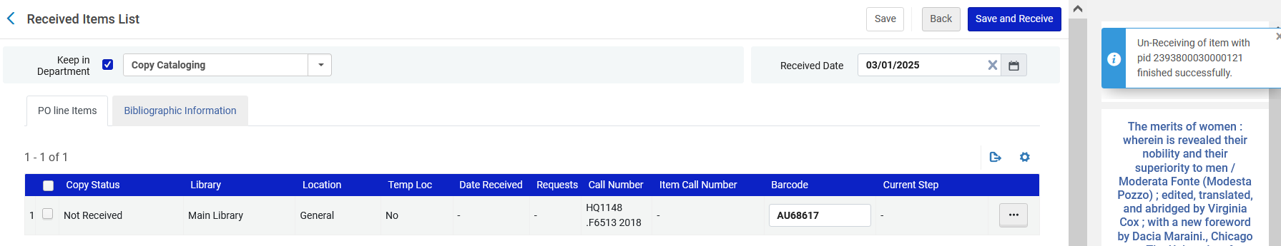
Unreceive the item
The staff user receives a message that the Un-Receiving of the item finished successfully.

Slide 22
Unreceive the item
A physical items search for the item no longer shows it as
  Process type: Acquisition technical services (CopyCat)
    Now the Process type is "Acquisitions"
  At: Acquisitions Department
    This no longer appears
  Receiving Date: Jan. 03, 2025.
    Now there is no "Receiving Date"

Slide 23
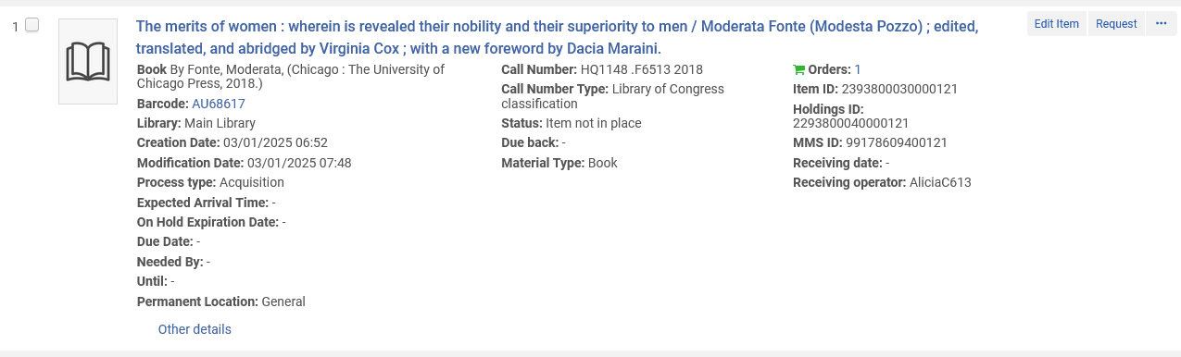
Unreceive the item
A physical items search for the item
There is no Receiving date
There is no "At: Acquisitions Department"
The Process type is "Acquisitions"

Slide 24
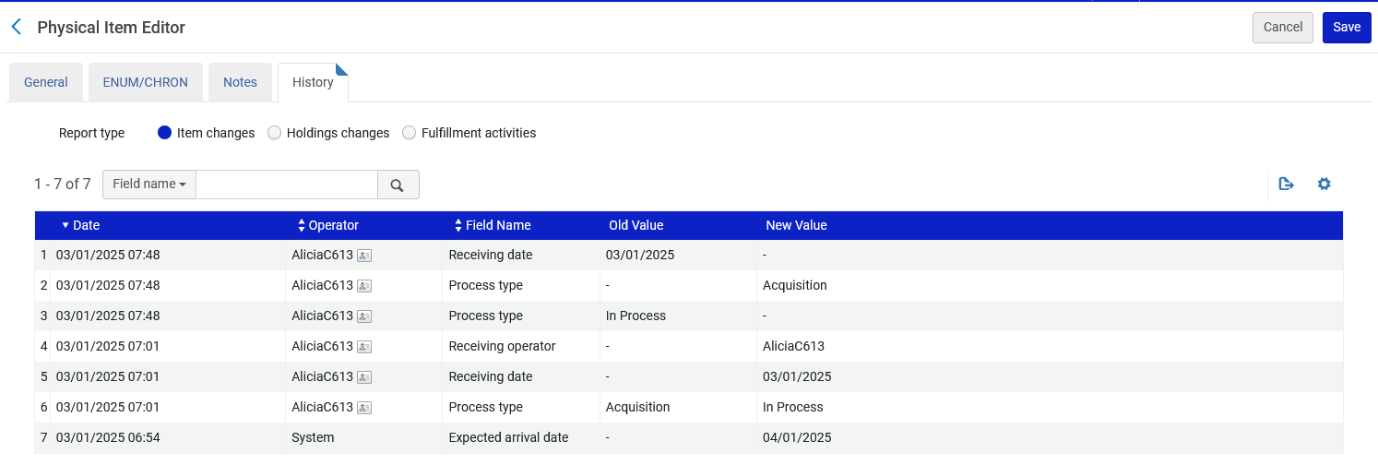
Unreceive the item
In the item history we can see that the Receiving date was removed.

Slide 25
Unreceive the item
If the staff user, while still at the "Main Library – Acquisitions Department", does "Fulfillment > Resource Requests > Monitor Requests & Item Processes" then he or she will see that there is no longer a Work Order on the item.

Slide 26
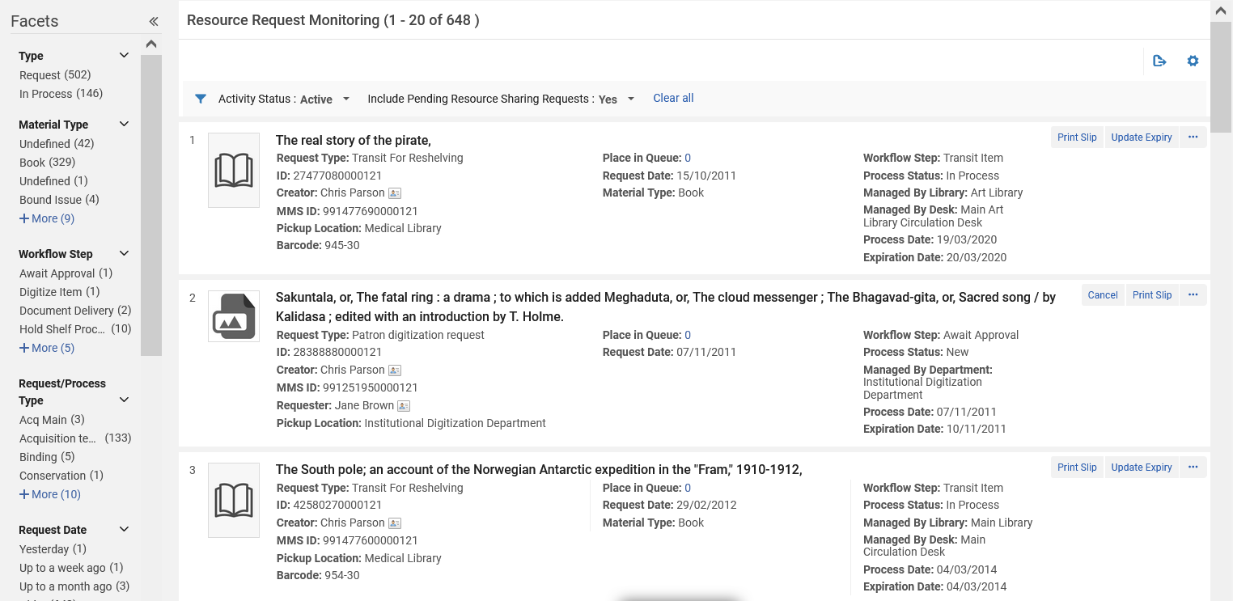
Unreceive the item
The item for title "The merits of women : wherein is revealed their nobility and their superiority to men" no longer appears when accessing "Monitor Requests & Item Processes"
There is no longer a Work Order on the item.

